Slide 1
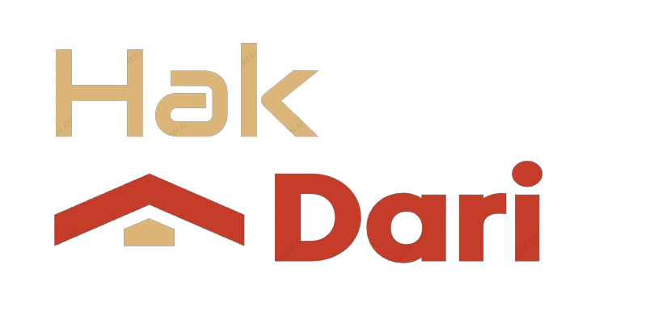
Real Estate Agency Management Application
A comprehensive solution for real estate agency operations and client management.

Slide 2




Project Overview
Property Management
Client Relationship
Transaction Tracking
Analytics and Reporting
Manage listings, track property details and owner information.
Maintain client profiles, communication logs, and potential buyer/seller data.
Monitor ongoing sales, closings, and commissions earned.
Generate reports on market trends, team performance, and agency growth.
This comprehensive application streamlines operations, enhances client experiences, and drives growth for real estate agencies.

Slide 3
Key Features
Property Management
A comprehensive suite for managing properties, including listings, contracts, and landlord-tenant relationships.
Lead and Client Tracking
Streamlined management of leads and clients, including contact information, notes, and communication history.
Transaction Management
Efficient handling of real estate transactions, encompassing offers, contracts, and closings, with seamless integration of electronic signature capabilities.
Marketing and Advertising
Robust tools for promoting properties and services, including website listings, social media integration, and targeted advertising campaigns.
Financial Reporting and Analysis
Detailed financial reporting and analytics, allowing for accurate tracking of income, expenses, and performance metrics.

Slide 4



Architecture
Describe the client-side components, such as the web application or mobile app, and their responsibilities in handling user interactions and displaying data.
Present a high-level overview of the system architecture diagram, highlighting the key components and their interactions.
Explain the server-side components, including the application server, database, and any other services or APIs used by the system.
Illustrate the data flow between the front-end and back-end components, indicating how user requests are processed, and data is exchanged.
Explain the Architecture Diagram
Front-End Components
Back-End Components
Data Flow
Integration Points
Security Considerations
Scalability and Reliability
Highlight any external systems or third-party services that the application integrates with, such as property listing platforms or payment gateways.
Discuss the security measures implemented in the architecture, such as authentication, authorization, and data encryption mechanisms.
Explain how the architecture is designed for scalability and reliability, including load balancing, caching, and failover strategies.

Slide 5




Development Roadmap
2025 Q3
2024 Q3
2025 Q1
Implement AI-powered property valuation and recommendation engine
Release MVP with core property listing and search functionality
Integrate payment gateway and introduce premium features for agencies
2024 Q4
2025 Q2
Enhance user experience with real-time notifications and intuitive dashboards
Launch mobile apps for iOS and Android to expand customer reach

Slide 6
“As a real estate agent, I need a centralized platform to manage my listings, client interactions, and schedules efficiently to enhance my productivity and deliver better service.”
REAL ESTATE AGENCY'S OWNER

Slide 7




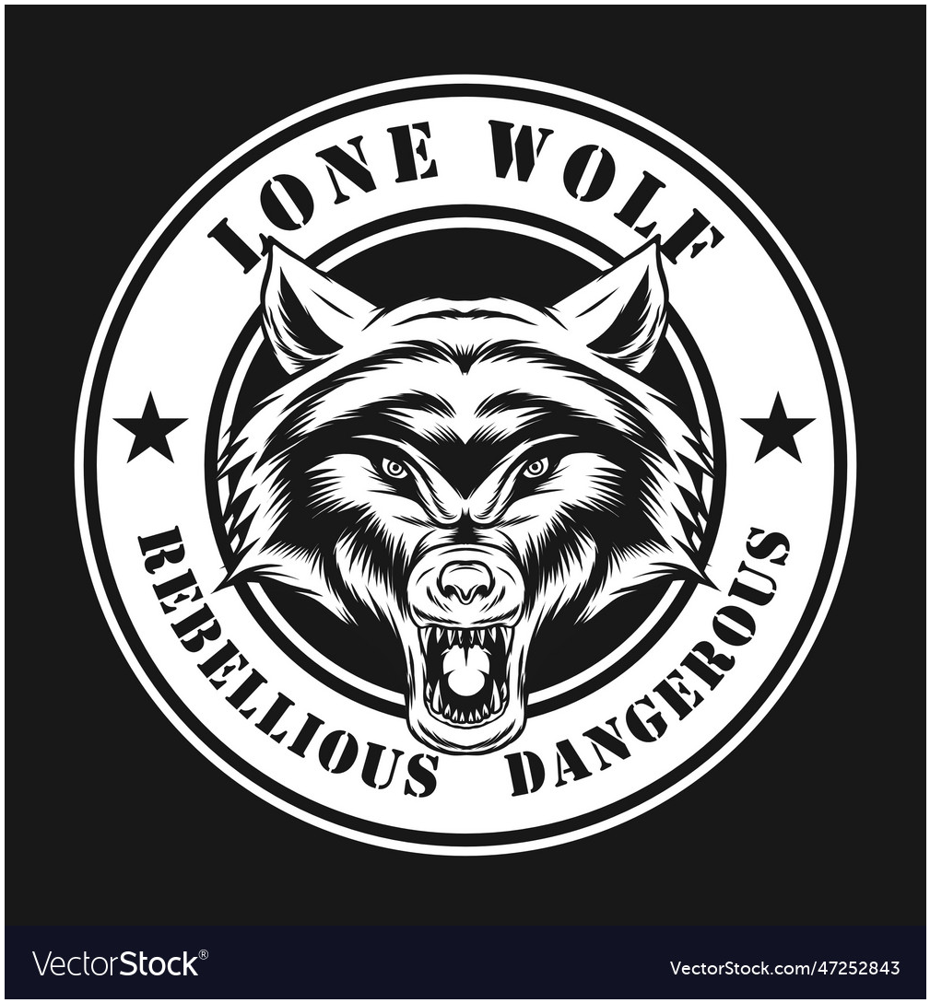



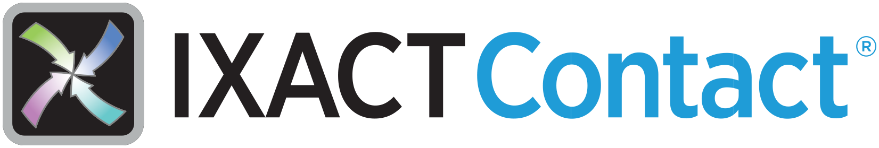

Competitive Landscape Outside Our Region

Slide 8
Detailed Intricacies
Frontend Framework
Backend Framework
Database
JavaFX, a comprehensive framework for creating rich desktop applications, provides efficient GUI development through its Scene Builder tool, enabling seamless integration and enhanced performance.
Java is a versatile and powerful programming language that enables developers to create robust, scalable, and cross-platform applications by leveraging its extensive libraries and object-oriented design principles.
MySQL, a widely-used relational database, offers efficient handling of real estate data, including multimedia content, with its scalable and adaptable design.
Authentication and Authorization
Mapping Integration (COMING SOON)
A secure and trusted means to authenticate users and grant access, safeguarding sensitive data within our database.
Google Maps API: Integration with Google Maps for displaying property locations, enabling features like searching by location, viewing nearby amenities, and providing directions to properties.

Slide 9




Increased Property Listing Visibility
Automated Commission Tracking and Reporting
Benefits
Centralized Client and Property Database
Seamless Team Collaboration and Communication

Slide 10
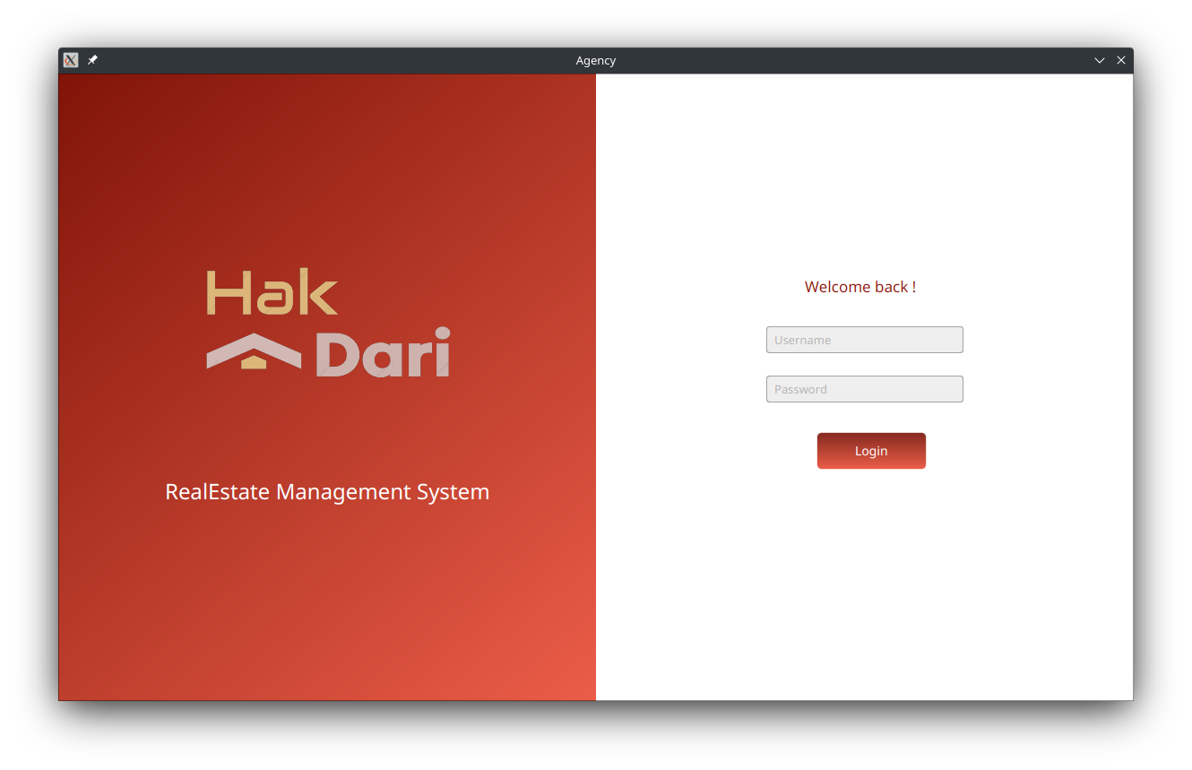
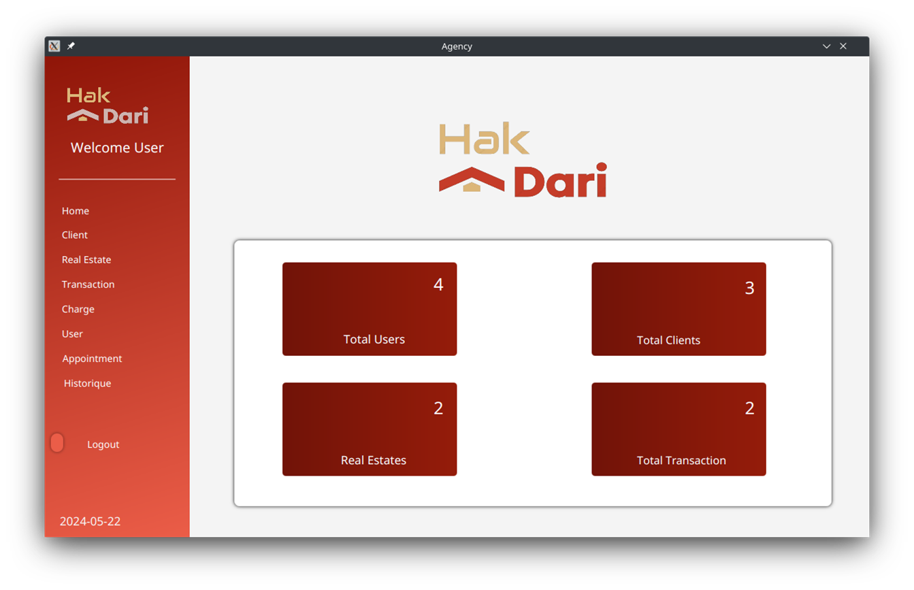
APP Overview :
After signing in you will enter the app as “user” and manage with your specific permissions

Slide 11
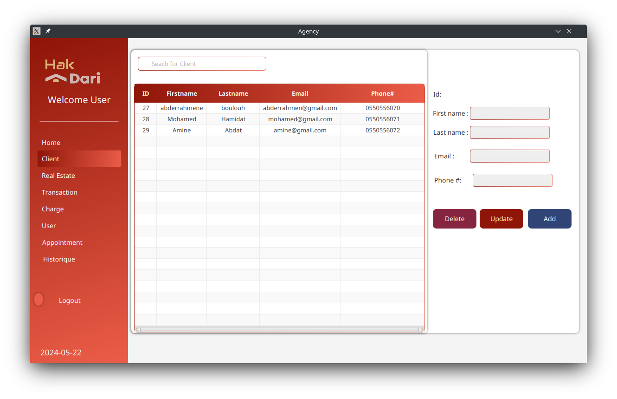
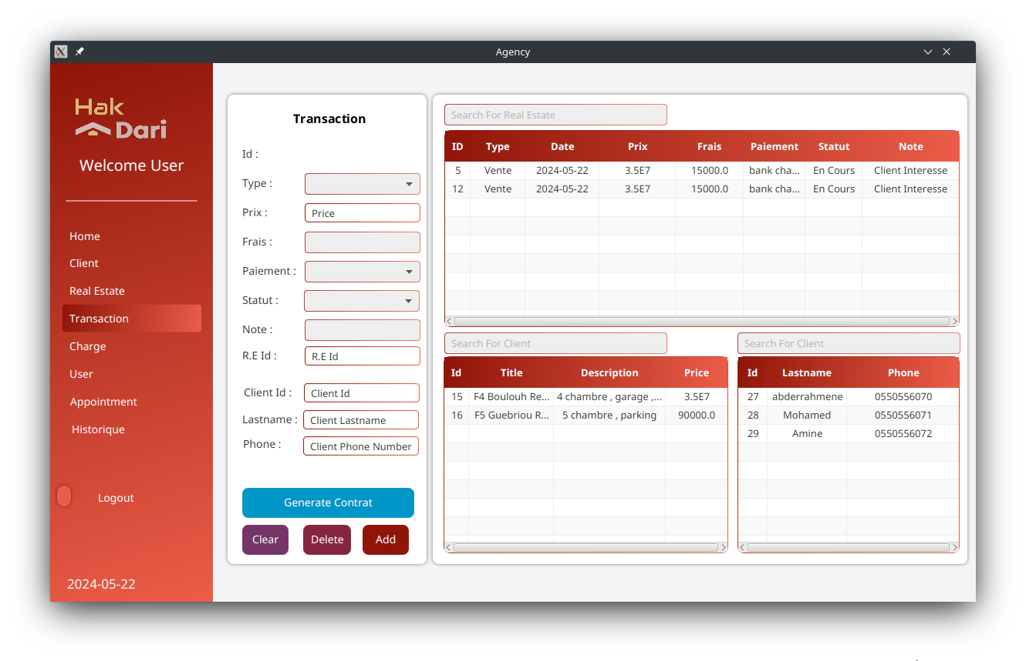
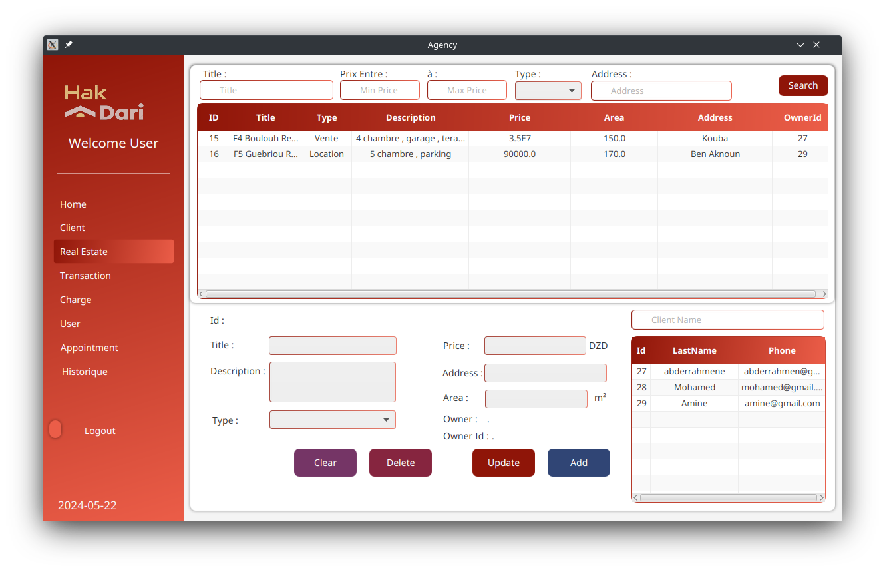
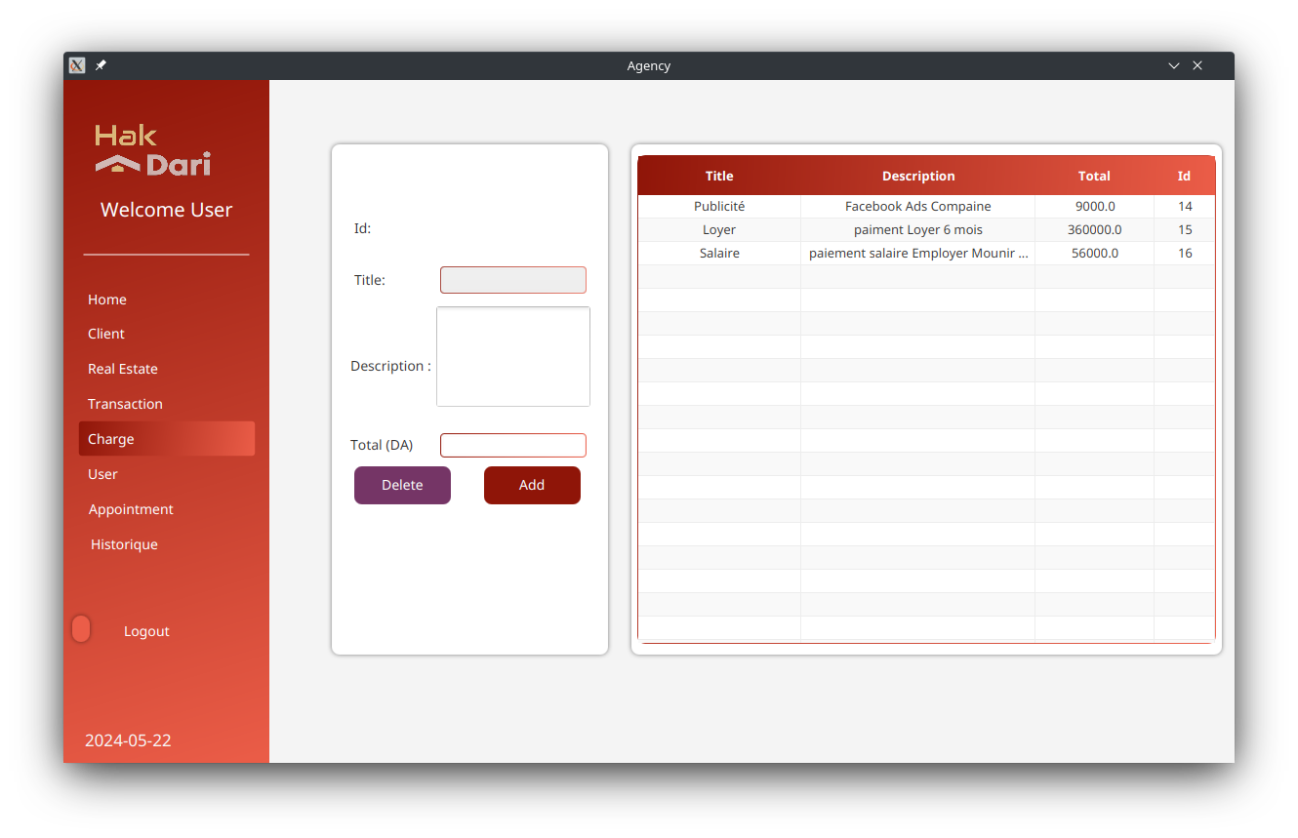

Slide 12
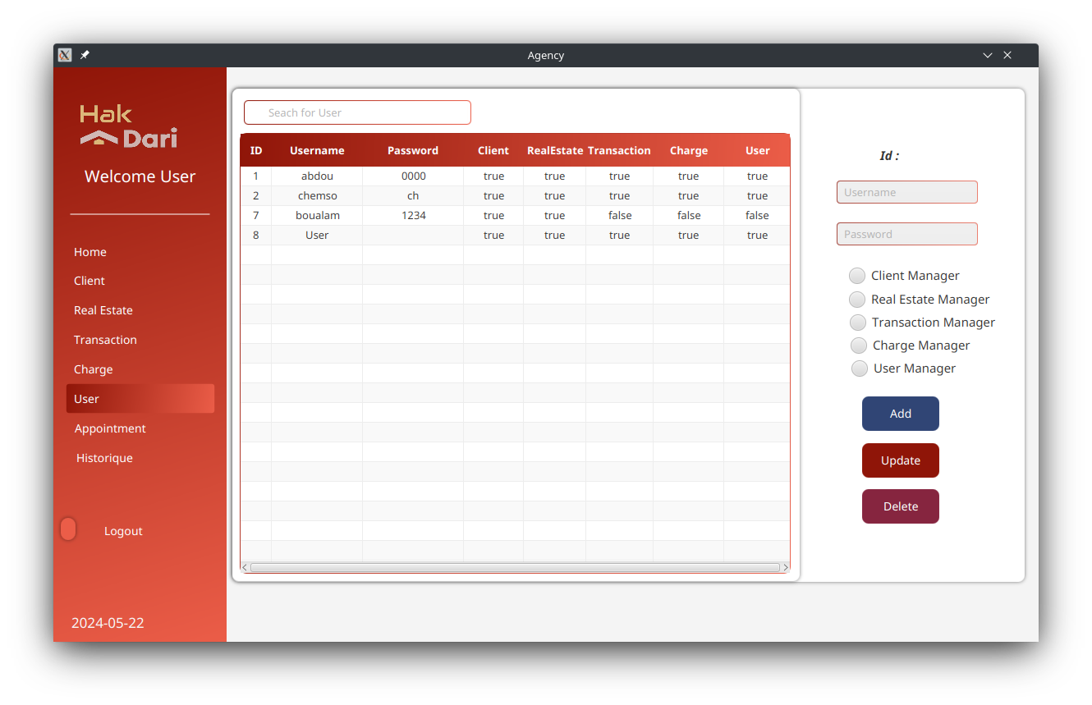
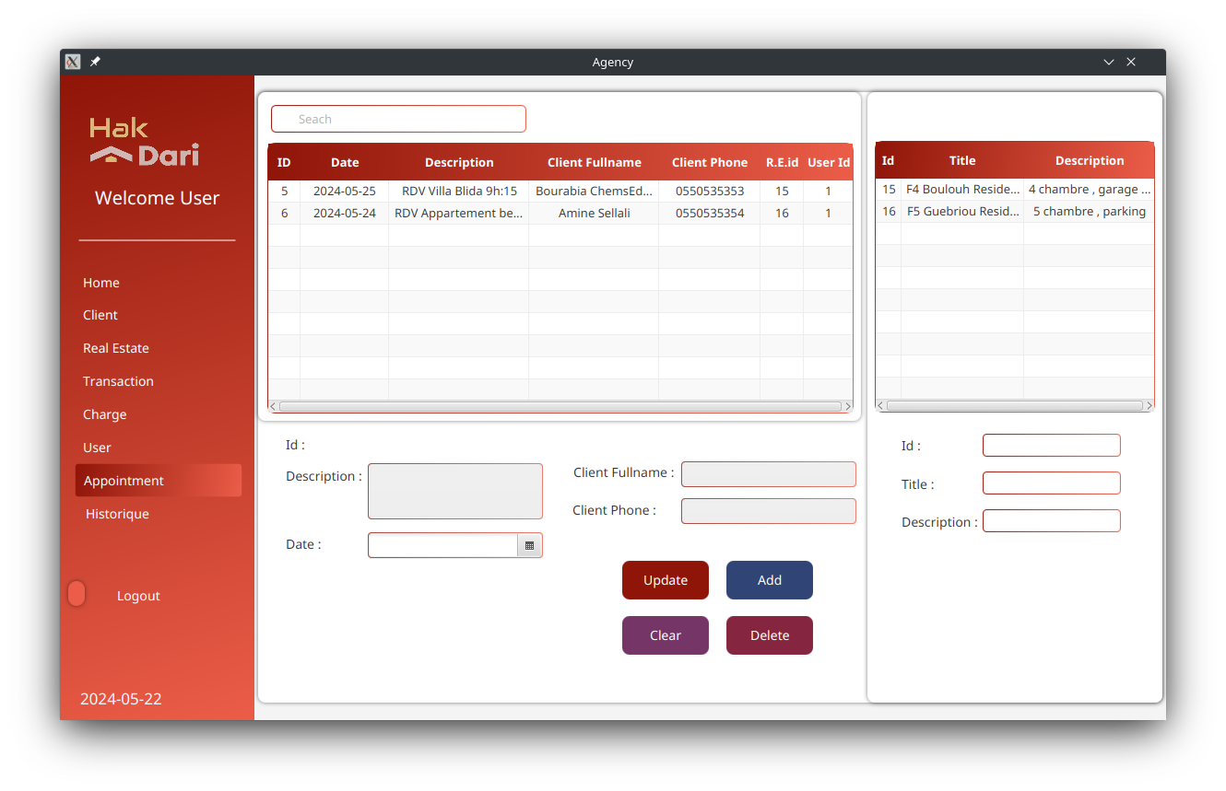
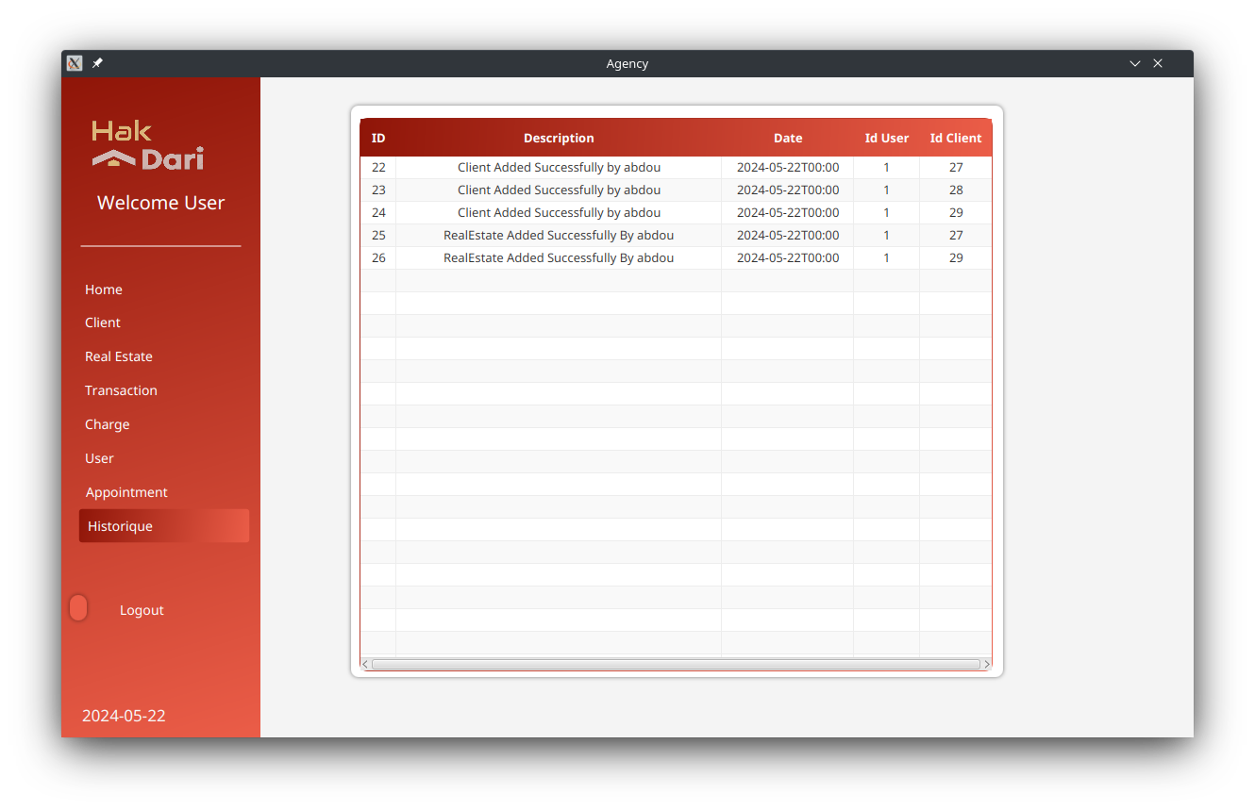

Slide 13





Market Opportunity
1
Total Number of Real Estate Listings Globally
2
Active Real Estate Agencies
3
Agencies Adopting Digital Solutions
4
Agencies Using Property Management Software
5
Our Target Addressable Market

Slide 14




Team :
BOURABIA Chems-eddine
BOULOUH Abderahman
HAMIDAT Mohamed-Abdallah
GHEBRIOU Khir-eddine
Project Manager and Database Admin
Lead Developer and Conceptor
UI/UX Designer and Redactor
Developer

Slide 15
Summary
Hak Dari, a comprehensive application, streamlines property management by centralizing listings, client interactions, transaction tracking, and reporting, enabling real estate professionals to efficiently oversee their operations.

